Slide 1

Srinivas
Day – 1

Slide 2

INTRODUCTION

Slide 3
SAP BTP
1. MTA Devlopment ( Multitarget archieve Application development )
1.1 Ui5 Application
1.2 Node JS Based cloud Application programming Model ( CAPM )
1.3 workflow -> Ui5
2. Business Rules
3. Job Scheduler
4. Business API Hub
5. Business Translations Hub
6. HANA XS JS / XS JS Advanced
7. FIORI portal service
8. Mobile ( Mobile Services )
8.1 SAP MDK ( Mobile Development KIT )
8.2 SAP APPGyer
8.3 SAP Mobile Cards
9. Hybrid Application Devlopment KIT ( HAT )
Pre-requiste : SAP BTP Account Created
SAP BAS ( Business Application Studio ) == Free Licence Visual Studio Code
Ui5 Application -> Java Script

Slide 4

Agenda – Day 1
What is SAP UI5?
Evolution of SAP’s UI technology
Tools to develop the UI5 and Fiori apps
UI5 Vs Fiori
BAS v/s VS Code
Introduction to BTP
Creating our first project
Introduction to Client Server Architecture
Introduction to HTML
HTML5 Basics
Structure of HTML Document
Introduction to Basic HTML Tags
Form and Form Submit in HTML
Different Type of Input Field in HTML
Creating UI5 Project
Understanding SAP UI Api reference with Controls
Controls and Its importance
Controls
-Properties
- Aggregtions

Slide 5


What is SAP UI5?
SAPUI5 is an HTML5 framework for creating cross-platform, enterprise-grade web applications in an efficient way.
SAPUI5 (SAP user interface for HTML5) is a collection of libraries that you can use to build desktop and mobile applications that run in a browser.
In simple words: SAP UI5 is a framework which is used to develop Responsive web applications to run on any platform, any browser and any OS.
Responsive web Application: It refers to the web apps that adapt different screen sizes, so the content looks great on any screen size.
Framework: A framework in programming is a tool that provides ready-made components or solutions that are customized in order to speed up development. In simple word a framework is a collection of Libraries.
Library: Collection of classes.
Classes: Collection of methods, Attributes, Events.

Slide 6
Evolution of SAP UI Technologies
Dynpro
Web Dynpro
WebGUI
BSP
SAPUI5
SAP FIORI 1.0
(2013)
SAP FIORI 2.0
(2016)
SAP FIORI 3.0
(2018)
A Small set of 25 application for tablet and phone
Desktop Scenarios
Native for iOS
More Advanced Features on the launchpad and overview pages
More Scalable content
Machine Learning Techniques Implemented
Native for Android

Slide 7
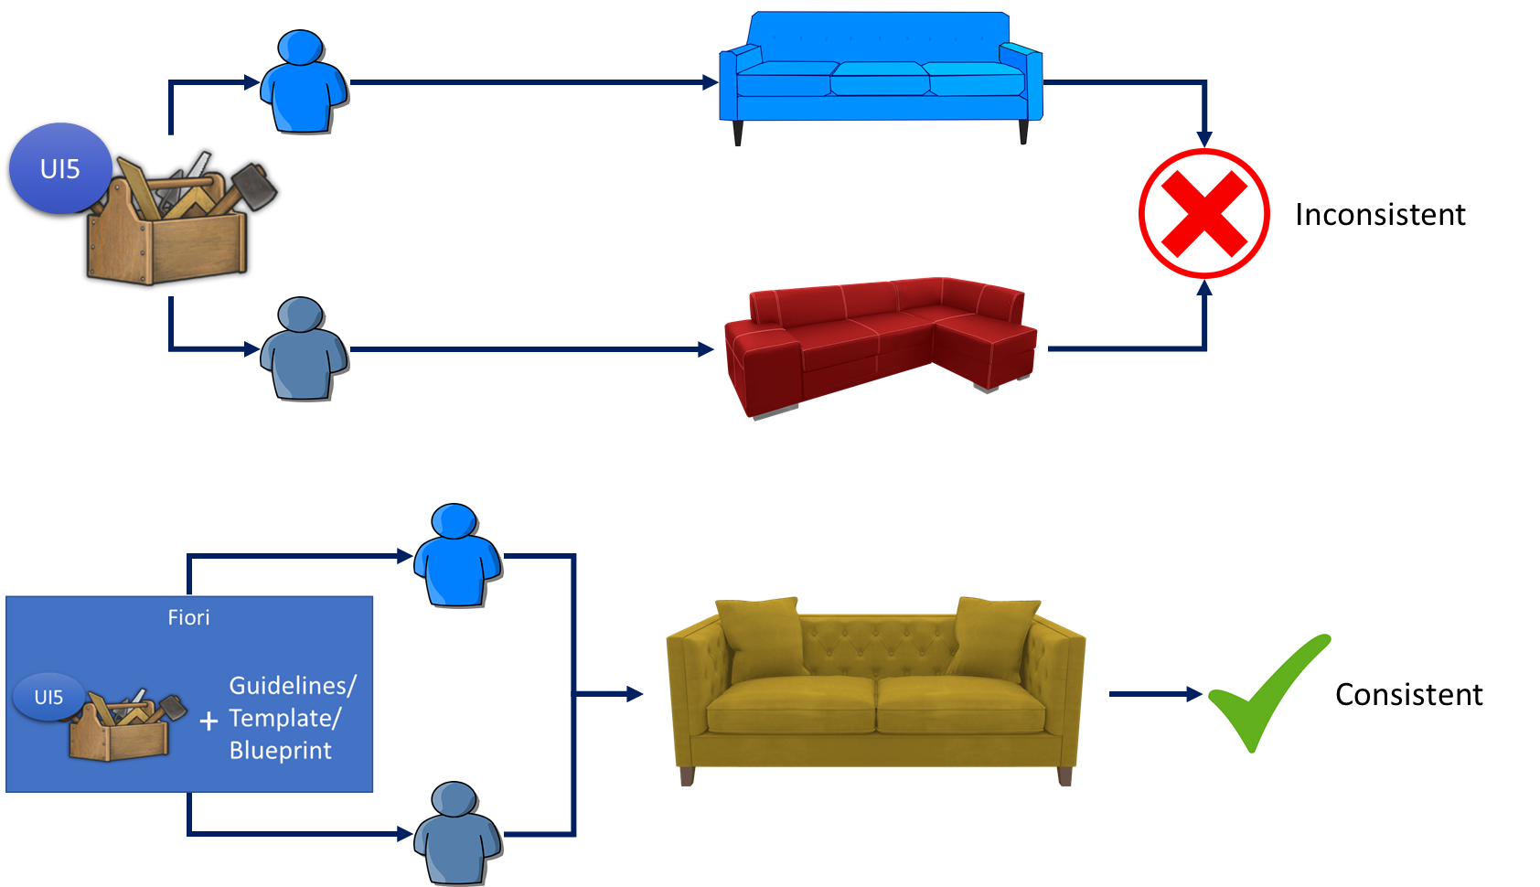
UI5 V/S Fiori
SAPUI5 is used to design UI but SAP Fiori is used to create User experience. Fiori apps are technically built on SAP UI5 only but they follow guidelines which are provided by sap and proven golden path for development of apps.
SAP Fiori provides also the pre-defined templates like master details, object list page, worklist etc. which brings our UI more closer to User experience.

Slide 8
User Experience v/s User Interface
UI stands for user interface but UX stands for User Experience
UI is technical view point of our application interface which will be used to take and provide information to the user but UX is psychological and emotions of the app.
We can change the UI but we cannot change UX
Take an example of modern world of apps, where no one needs to give you training to use amazon, uber, eBay etc.
User interface is developer oriented. This is purely technical. We can change UI any number of times.
User experience is user oriented. It is psychological. We cannot change UX.

Slide 9

What is Fiori?
SAP Fiori is the user interface or user experience (UX) that supplements and can replace the SAP GUI. This streamlined application uses tiles to encapsulate standard tasks, such as approving purchase requisitions, viewing sales orders, and approving timesheets.
Fiori is SAP’s new user experience. These are standard apps delivered by SAP and by following the Development guidelines any one can use UI5 to create Fiori Apps.
Fiori is a streamlined application, delivering a role-based user experience that can be personalized across all lines of business, tasks and devices.
It uses tiles to encapsulate standard tasks like viewing sales orders or approving timesheets.
Fiori = UI5 + Development/Design Guidelines

Slide 10
Structure of a Fiori App
There are different folders and directory are required for setup project: webapp, Controller, models, utils ,view, Component.js, manifest.json, index.html
Structure of normal ui5 application
Index.html
View
sap.app
title, description, version
2. Sap.ui
Sap.ui5
Controller
Structure of Fiori Application
Dev.
sap/ui/core/UIComponent
Index.html
Root View
App.view.xml
Component.js
View 1
Controller 1
Container
App (pages)
View 2
Controller 2
manifest.json
App descriptor
App.controller.js
BaseController
Component.js is starting point

Slide 11
Day2
Fiori / SAPUI5 follows MVC design pattern for application development
M -> Model ( Data ) -> local (json)/Remote(odata)
V -> View ( Presentation ) -> XML
C -> Controller ( M -> V ) / client side / sending to http request to server / calling additional UI user actions (JS)
SAP BAS / Visual Studio Code
SAP Cloud Edition Local / Personal Edition
SAP BTP Cloud Foundry Open Source
Licen. Free Licn.
Adoption Project Template N/A
MTA MTA
Run Visual Studio:
Visual Studio Download (https://code.visualstudio.com/Download )
Download / Install Node JS (https://nodejs.org/en/download/ -> check node -v )
Install/Configure Fiori plugins ( Goto Extensions inside Visual Studio Code -> search fiori -> install top 5 search entries
Install FIORI Application Generator ( view menu -> command palate -> Fiori application generator )
Create UI5 Application
Run the Application (view-> ctl+shft+p(command pallete) -> Fiori application info -> preview application)

Slide 12
1. SAP BTP ?
-> BTP ( Business Technology Platform )
-> Cloud ( PAAS ) -> Platform as a service
-> Full Stack Devlopment ( End to End Devlopment ) ( UI + Backend Data )
-> Approval Process
-> Busines Rules ( Functional Users / Business Team ) -> excel -> DataDecison
-> Workflow ( process automation )
-> Business Translations Hub
-> SAP Event Mesh
..
..
.
.
.
-> MTA ( Multi Target Archieve Application Devlopment )
-> Ui5 Front End ( en, ch, arabic )
-> Database / HANA / SQLLITE / Postgres
Server Technololigies ( Node JS ) + Abap on Hana ( cloud ) -> RAP
2. SAP BTP HANA ?
CAPM -> Cloud Application Programming Model
1. Abap on Hana ( RAP )
2. Nodejs
3. Java Struts
3. SAP S4/HANA Cloud Extensability ?
FIORI
Adoption
In-App
SideBYSide
4. SAP WEBIDE / SAP BAS ( Devloping UI5 Applications )
SAP WEBIDE -> Tool to Devlop only Ui5 Applications
-> Neo
-> Advanced version of the Eclipse
-> Licen,
SAP BAS -> Tool to devlop not only ui5 applications / CAPM / S4/HANA
-> CF
-> Advanced version of the SAP WEBIDE
-> Licen.
-> Cloud
Visual Studio COde : Freelicene
: Provides all features of SAP BAS
: Local / Personal / without internet
5. UI5 / FIORI
--
Ui5 is a framework to devlop Responsive ( Web, Tab, Mobile Device ( Android / ios ) )
FIORI Design guidelines / Priniciple / Prototype
*************
FIORI LIB:
-
https://fioriappslibrary.hana.ondemand.com/sap/fix/externalViewer/#/detail/Apps('F6117')/S24OP
FIORI GUideLines
--
https://experience.sap.com/fiori-design-web/multiinput/#properties
Implementation:
https://ui5.sap.com//#/entity/sap.m.MultiInput/sample/sap.m.sample.MultiInput/code

Slide 13
Create Leave Approve Screen :
--
Screen Level Development ( View )
List/Tables of Leaves
Approve / Reject
Search Bar
Selection / Single / Multiple
Model
--
List of Leaves -> JSON Model ( Mock Data / Dummy Data)
List Of Leaves -> Hana Table / Z*Table ( Remote Data ) (ODATA)
Filters , Sort
Controller ( Screen Validations )
--
1. Without Leave Selection we shouldn’t allow them to Approve / Reject
2. Without any entry shouldn’t allow to filter
3. All Leave Items are empty , Not enable ( Approve / Reject ) Buttons

Slide 14
IN Ui5 To Develop screens we need controls / Ui5 Elements
Page Control -> Super
List of Leaves -> List
Search -> SearchField
Approve/Reject -> Button
Filter -> Filter Class
Sort -> Sort Class
Controls : ( sap.m, sap.ui.commons, sap.layout.* , sap.ui.core, ….)
---
1. Properties ( Behaviour -> enabled, text, color, icon ,….. )
2. Aggregations ( A control Inside Place a another control is helped by Aggregations ) -> Page -> List, Search, Button..
-> List -> ObjectListItem, DisplayListItem, SimpleListItem…
3. Methods ( Apply dynamically / runtime behaviour ) (Proprties -> set ***** / get****() )
4. Events ( User Actions )
Ui5 Bible : https://ui5.sap.com
Page -> Header , Body, Footer
Aggregations
header
subheader
footer
content

Slide 15
Control :
---
Properties :
Syntax :
<UiElement propertieslist…></UiElement>
Ex:
<Button text=“Approve”></Button>
<List mode=“SingleSelectMaster”></List>
<StandardListItem title=“Sss”></StandardListItem>
Take away Points:
1. Always use “Case Senstative “ << lower >> <<upper >>
2. All properties will start with lowercase and separted by eachword will start with uppercase
Ex: StandardListItem
3. Properteis always defined with in the control
4. Properties has to defined with associated type

Slide 16
Controls :
Events
syntax:
view
<UiElement eventname=“functionname”></UiElement>
controller functionname: function (){ // begin scope
// body of the function
}//end scope
Ex:
<Button press=“handlePress”/>
handlePress: function () {
}
Learning Pre-Requisite : Java Script

Slide 17
Day 5:
--
SAPUi5 Controls / UI Elements :
-----
1. Properties
2. Aggregations
3. Methods
4. Events
--
Properties : -> are used to define / nature towards the UI element.
ex: Button > text nature => <Button text=“Approve”/>
List > selection nature => <List mode=“SingleSelectMaster”/>
Page > title -> display the title towards page => <Page title=“Approve App”/>
2. Methods -> are used to apply nature/define behaviour dynamically. Set of methods where It will combine set*** and get**
ex: Runtime -> Button text, visability, enabled/disable / type-> color => setText(), setVisible(), setEnabled(), setType()
> List -> mode -> single Selection, multiple -> setMode()
3. Events -> are used to apply user actions
ex: Button -> click -> press
List -> selecting -> selectionChange , delete

Slide 18
Aggregations:
--
Aggregations are used to place a control inside another control.
Page Control will allow all different controls to place inside using aggregations.
Page Control
Button, List, Dropdown, Datepicker
Page -> content, headerContent, subHeader, footer
List -> items
Select -> items
Table -> header, columns
Control -> Always Starts with Upper Case
Aggregations -> Always Starts with lowercase and separated by each word in upper case

Slide 19
Models:
--
JSONModel
ODataModel
Resource Model
XML Model( Deprciated )
--
JSONModel : Help to load local data / dummy data
ODataModel : Help to load remote data / Odata
Resource Model : Help to place i18n ( language support )
Steps to Use JSON Model
Create JSON Data. // Service
{
“leaves”:[], // Entity Set ( EndPoint )
“leaveTypes”:[],
“Departments”:[]
}
2. Create JSONModel Object
var localModel= new sap.ui.model.json.JSONModel();
------------------------ -----
namespace ObjectName<<Class>> 3. set data to localModel localModel.setData(step1); 4. set local Model to view 4.1 Get View and then set this.getView().setModel(localModel); -- Controller / method to get the view / setModel 5. Apply Binding in the view
Binding: {} 1. Aggregation Binding {/tableData} 2. Element Binding {/structure} 3. Property Binding {singleproperty}
Take Away Points:
Models we can use multiple for single view or complete Project Single model will be used with default model. Need to more than single , it will be named model …

Slide 20
// viewObj.setModel(jsonModel); // Default Model
viewObj.setModel(jsonModel, "localModel"); // Named Model
Named Model:
--
viewObj.setModel(jsonModel, "localModel"); // Named Model
Binding in the view
--
modelName>/context
modelName>propertyName

Slide 21
Table -> Aggregations
columns
items
..
.
Columns -> Column1 , Column2
items
items

Slide 22
JSONModel : Globally Use
I want to use all my data in all my views ( view1, view2, …)
Approach1:
****
Goto Component.js
Copy All lines from controller and add into component.js inside
*************
Approach2:
--
1. Define ***.json file
2. set jsonfile to jsonmodel
3. call jsonmodel inside manifest.json
Controller
Manifest.json
Component.js
Approach 3:
1. Controller Leve

Slide 23
Odata Model :
--
<protocol>: servicename: <context>?uri option / https://services.odata.org/v2/northwind/northwind.svc/$metadata
https://xyz.com/sap/opu/odata/sap/ServiceName/$metadata
Open Data model, It follows all REST principles. GET
POST
PUT
DELETE
Odata will offer by default XML format data, on-demand with URI option it will serve the data in json, xlsx and plain text.
Ex: …. ?$format=json
….?$format=xlsx
Odata by default adjust with the top and skip parameters through to serve the data in a pagination format.
..?$top=0&$skip=10
..?$top=100&skip=200
Odata we have defaulted with filter options and sorting the data.
..?$filter=fieldname <eq> <bt> <GE> <LE> value
Note: $metadata : Metadata is provide all about service details with help entity type, entity set and field names.
Each filed names also provide label, description, size, data type, filterable, nullable ,…..
Note : From UI always for our first hit to the odata is metadata.

Slide 24
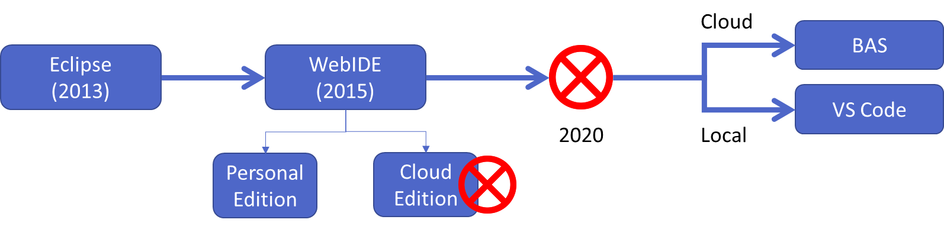
Tools to Create SAP UI5 and Fiori Apps
Deprecated

Slide 25
BAS v/s VS Code
Visual Studio Code
(VS Code)
Business Application Studio (BAS)
Pros
Lifetime free for anyone
Its an open source by Microsoft
Industry standard
Offers lots of plugins for developers
Complete local development (offline)
Cons
Acquire space in your computer
Do installation for everything needed in local machine
In case system crash, code will be gone if you not backup.
Steps
Node JS (min v12) - https://nodejs.org/en/
Download VS Code
https://code.visualstudio.com/download
3. Go to VS Code Extension and search fiori, install SAP Fiori Extension pack
Multi cloud dev tools like fiori, hana XSA, CAPM...
Pros
Trial is free for 365 days to learn BAS
No Setup required in local machine
Any device, any time, any browser
Recommended tool by sap for fiori development
Cons
Costly
Requires all time connectivity
Slow
Steps
Register free account on https://www.sap.com
Login to BTP https://account.hanatrial.ondemand.com/trial/
Click on BAS on home page and create a new dev space

Slide 26
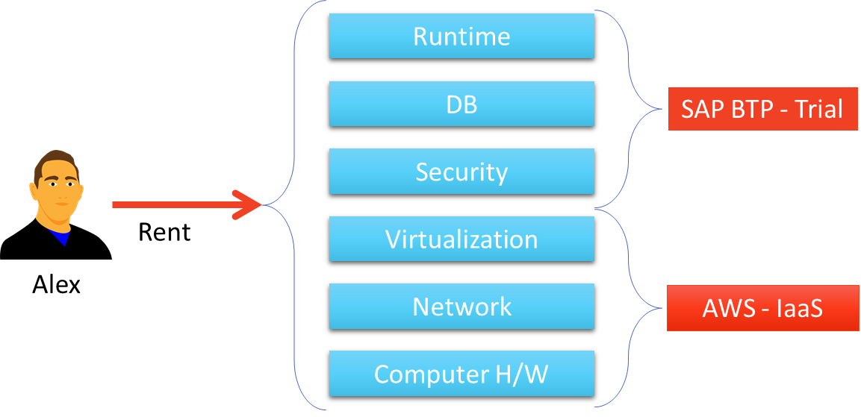
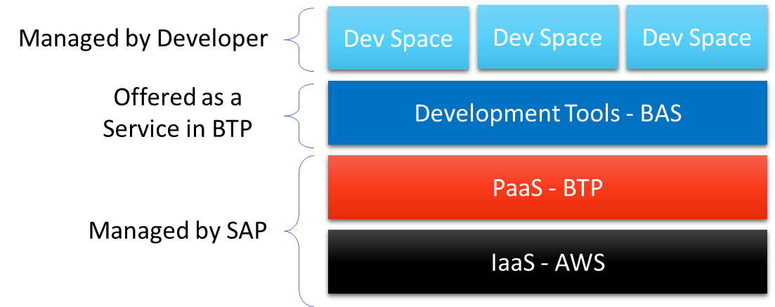
Intro to BTP - Business Technology Platform
BTP is a Platform as a Service provided by SAP to build, design, develop, test, manage end-to-end applications in cloud.
It can help develop the exact application needed quickly, easily, and economically. All this without investing in local infrastructure.
BAS is an on demand development tool provided as a service in BTP.
In BAS we can do variety of development and to achieve the same, we need to create dev space where we add the code. Actually its virtual machine running on AWS (Linux).

Slide 27
Client Server Architecture
Client-server architecture is a shared computer network architecture where several clients (remote system) send many requests and finally to obtained services from the centralized server machine (host system). Client machine delivers user-friendly interface that helps to users to fire request services of server computer and finally to show your output on client system.
SAP Server Computer on cloud IP Address
Server
Request – header + body(optional)
Browser
JS Code
Response – header + body(html, xml, json, excel, pdf, word,….)
Node JS
Types of Requests
GET – Read Data
POST – Create new Data
PUT – Update
DELETE – Remove Data
Types of Responses
Html
Plain text
Image/ file
Json
Xml
…
Ways to make Request
Form submit
HTTP Request
Ajax Calls
ABAP
Java
,NET
Java Script

Slide 28
Creating First Project
Create a Page with a Button using below code:
Steps to create a Project in BAS tools:
Open the terminal window and write command mkdir firstproject this will create a folder with name firstproject in our projects directory.
Create a folder named webapp inside the new firstproject folder. We have created this folder to follow the industry standards.
Now create a file named index.html inside the webapp folder.
Now write the code in the index.html file.
Code:
<html>
<head>
</head>
<body>
Welcome to ReserveBankOfIndia
</body>
</html>
You can Copy the code form here: index.html

Slide 29
Java Script Call back function :
A callback function is a function passed into another function as an argument, which is then invoked inside the outer function to complete some kind of routine or action.
Or
"I will call back later!" A callback is a function passed as an argument to another function. This technique allows a function to call another function. A callback function can run after another function has finished.
function greeting(name) {
alert(`Hello, ${name}`);
}
function processUserInput(callback) {
const name = prompt("Please enter your name.");
callback(name);
}
processUserInput(greeting);

Slide 30
Java Script Promises Continue…:
Parameters Promise constructor takes only one argument which is a callback function (and that callback function is also referred as anonymous function too).
Callback function takes two arguments, resolve and reject
Perform operations inside the callback function and if everything went well then call resolve.
If desired operations do not go well then call reject
var promise = new Promise(function(resolve, reject) {
const x = "geeksforgeeks";
const y = "geeksforgeeks"
if(x === y) {
resolve();
} else {
reject();
}
});promise.
then(function () {
console.log('Success, You are a GEEK');
}).
catch(function () {
console.log('Some error has occurred');
});

Slide 31
Java Script Promises:
Promises are used to handle asynchronous operations in JavaScript. They are easy to manage when dealing with multiple asynchronous operations where callbacks can create callback hell leading to unmanageable code.
Benefits of Promises
Improves Code Readability
Better handling of asynchronous operations
Better flow of control definition in asynchronous logic
Better Error Handling
A Promise has four states:
fulfilled: Action related to the promise succeeded
rejected: Action related to the promise failed
pending: Promise is still pending i.e. not fulfilled or rejected yet
settled: Promise has fulfilled or rejected
A promise can be created using Promise constructor. Syntax
var promise = new Promise(function(resolve, reject){
//do something
});

Slide 32

Introduction to HTML
HTML stands for Hyper Text Markup Language.
It is used to design static web content. HTML is developed and designed by org named W3C – World Wide Web Consortium.
Markup language is used to define the text document within tag which defines the structure of web pages.
HTML5 is the fifth and current version of HTML. It has improved the markup available for documents and has introduced application programming interfaces(API) and Document Object Model(DOM).
History of HTML
W3C – World Wide Web Consortium
Is an organization and all the browser vendors (chrome, IE, Edge, Firefox) are part of it and comply to w3c standards
https://www.w3schools.com/
Year | Version
1990 | HTML
1993 | HTML 2.0
1995 | HTML 3.2
1999 | HTML4
2014 | HTML5

Slide 33
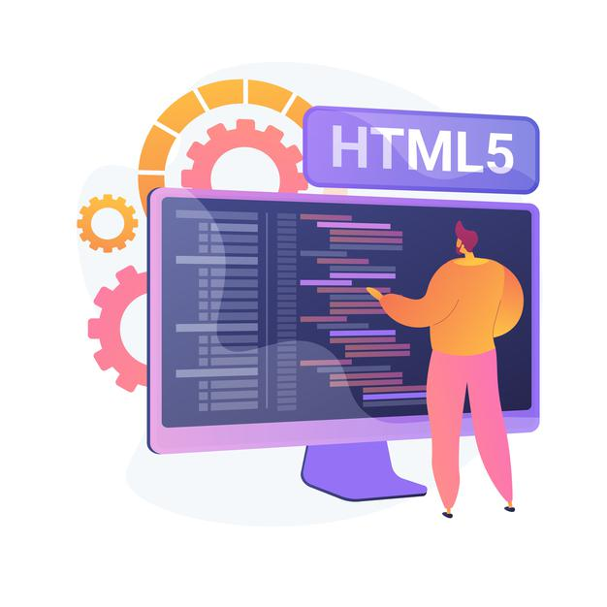
HTML Basics
All the Browsers directly understand HTML
HTML is not programming language
HTML is tag based
<tagName prop=“val” prop2=“val”>content</tagName>
All the tags are provided by – W3C – Documentation - https://www.w3schools.com/html/default.asp
Every HTML page consists of 2 parts
Header – Brain of html
Body – Content of HTML Document
HTML is a tree data structure – this is what is rendered when we execute an HTML and this runtime tree is called DOM (Document Object Model)
We can check the DOM by press F12 and going to elements section or we can right click on a web page and select the Inspect option to see the DOM.
Every HTML Element can have a id property which uniquely identifies that element on entire page.
We can also have a name property which is not unique but help us to understand the semantic meaning of the field.

Slide 34
Structure of the HTML document
<html>
<head>
<title>
</title>
</head>
<body>
</body>
</html>
This is called HTML root element and used to wrap all the code.
This contains the information about the HTML document. For Example, Title of the page, version of HTML, Meta Data etc.
This contains everything you want to display on the Web Page.
<html>: This is called HTML root element and used to wrap all the code.
<head>: Head tag contains metadata, title, page CSS etc. All the HTML elements that can be used inside the <head> element are: <style>, <title>, <base>, <noscript>, <script>, <meta>
<body>: Body tag is used to enclose all the data which a web page has from texts to links. All the content that you see rendered in the browser is contained within this element.

Slide 35
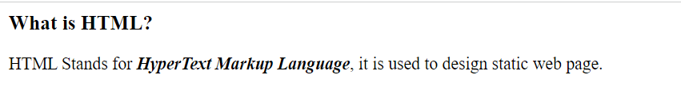
Introduction to Basic HTML Tags
HTML tags are like keywords which defines that how web browser will format and display the content.
Many elements have an opening tag and a closing tag — for example, a p (paragraph) element has a <p> tag, followed by the paragraph text, followed by a closing </p> tag.
Some elements don’t have a closing tag. These are called empty elements. For example, the br element for inserting line breaks is simply written <br>.
Now let’s look at some common tags used in html page:
<h1> to <h6> – Heading Tags: The <h1> to <h6> tags are used to define HTML headings. <h1> defines the most important heading. <h6> defines the least important heading.
<p> – Paragraph Tag: The <p> tag defines a paragraph. Browsers automatically add a single blank line before and after each <p> element.
<em> – Emphasized Tag: The <em> tag is used to define emphasized text. The content inside is typically displayed in italic.
<b> Tag: The <b> tag specifies bold text without any extra importance.
<br> Tag: The <br> tag inserts a single line break.

Slide 36
Basic HTML Tags Continue…
<title> – Title Tag: The <title> tag defines the title of the document. The title must be text-only, and it is shown in the browser's title bar or in the page's tab.
<meta> – Meta Tag: The <meta> tag defines metadata about an HTML document. Metadata is data (information) about data.
<a> – Anchor Tag: The <a> tag defines a hyperlink, which is used to link from one page to another. The most important attribute of the <a> element is the href attribute, which indicates the link's destination.
<img> – Image Tag: The <img> tag is used to embed an image in HTML Page.
<input> – Input Tag: The <input> tag specifies an input field where the user can enter data. The <input> element is the most important form element.
<label> – Label Tag: The <label> tag defines a label for several elements like <input> tag.

Slide 37
Hands – on: Basic HTML Tags
Create a simple HTML page using the basic HTML Tags like <h1> to <h6>, <p>, <em>, <b>, <img> and <a>.
Code Links:
index.html
image

Slide 38
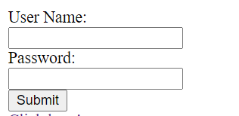
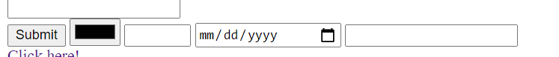
Form, Form Submit and Input Field Types
Form in HTML
The <form> element is a container for different types of input elements, such as: text fields, checkboxes, radio buttons, submit buttons, etc.
The HTML <form> element is used to create an HTML form for user input.
The user input is most often sent to a server for processing.
Submit Button
The <input type="submit"> defines a button for submitting the form data to a form-handler.
The form-handler is typically a file on the server or a web page with a script for processing input data.
The <input> Element
The HTML <input> element is the most used form element.
An <input> element can be displayed in many ways, depending on the type attribute.
Here are some examples:
<input type="color">
<input type="number">
<input type="date">
<input type="email">

Slide 39
Hands – on: Form and Form Submit
Create a form using the input and label elements and also create a submit button using the input field of type submit.
Also check the different type of input field by changing the type attribute of the input tag.
You can check all the values in the type attribute on the w3c documentation for the input tag: https://www.w3schools.com/tags/tag_input.asp
Code Links:
index.html

Slide 40
Block Level and Inline Elements in HTML
Block Level Elements
A block-level element always starts on a new line.
A block-level element always takes up the full width available (stretches out to the left and right as far as it can).
A block level element has a top and a bottom margin, whereas an inline element does not.
The <div> element is a block-level element.
div – division tag – it is used to divide screen in multiple group of elements. Every div element always starts with new line.
Here are the some block-level elements in HTML:
<p> <div> <li> <hr> <video> <h1> to <h6> etc.,
Inline Elements
An inline element does not start on a new line.
An inline element only takes up as much width as necessary.
This is a <span> element inside a paragraph.
Here are the inline elements in HTML:
<a> <input> <button> <span> <textarea> etc.,
Block Level Elements
Element 1
Element 2
Element 3
Element 4
Inline Elements
Element 1
Element 2
Element 3
Element 4

Slide 41
Ordered and Unordered List
HTML lists allow web developers to group a set of related items in lists.
Unordered HTML List:
An unordered list starts with the <ul> tag. Each list item starts with the <li> tag.
The list items will be marked with bullets (small black circles) by default.
Ordered HTML List:
An ordered list starts with the <ol> tag. Each list item starts with the <li> tag.
The list items will be marked with numbers by default.
An unordered HTML list:
Item
Item
Item
Item
An ordered HTML list:
First item
Second item
Third item
Fourth item

Slide 42
Introduction to Multimedia Tags in HTML
Multimedia on the web is sound, music, videos, movies, and animations.
Audio
The <audio> tag is used to embed sound content in a document, such as music or other audio streams.
The controls attribute adds video controls, like play, pause, and volume.
Video
The <video> tag is used to embed video content in a document, such as a movie clip or other video streams.
The controls attribute adds video controls, like play, pause, and volume.
Iframe
The <iframe> tag specifies an inline frame.
This is the easiest way to embed videos in HTML.
An inline frame is used to embed another document within the current HTML document.
We can also use <iframe> element to add YouTube videos in our web page.

Slide 43
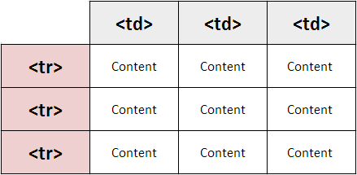
Introduction to Table element in HTML
HTML tables allow web developers to arrange data into rows and columns.
A table in HTML consists of table cells inside rows and columns
The <table> tag defines an HTML table.
An HTML table consists of one <table> element and one or more <tr>, <th>, and <td> elements.
The <tr> element defines a table row, the <th> element defines a table header, and the <td> element defines a table cell.
By default, the text in <th> elements are bold and centered, but you can change that with CSS.

Slide 44
Introduction to CSS
Inline style CSS
Internal style CSS
Concept of Box Model in CSS
Concept of Pseudo Classes in CSS
External style CSS
What is JavaScript?
Basic usage of JavaScript
Important Points about JavaScript
Variables and Data Types
Arrays and Objects in JS
How to Apply JS to HTML Page
Inline and Internal JS
Changing CSS at runtime
Adding Dynamic Content
Debugging
Synchronous and Asynchronous Response
External JS

Slide 45

Introduction to CSS
CSS Stands for Cascading Style Sheets, it is used to format/beautify the HTML content.
CSS describes how HTML elements are to be displayed on screen.
CSS saves a lot of work. It can control the layout of multiple web pages all at once.
We need CSS because HTML can only generate static content w/o coloring, formatting, borders, beautification.
Before css we have to use HTML tags for formatting which was very cumbersome
<p>I <b><color value=“red”>love</color></b><font val=“Calibri”>India<font></p>
There are 3 ways we can apply CSS on HTML Content
Inline CSS – applied at each element level <tagname style=“prop:val;prop:val;..”>….
Internal CSS – applied at the page level to target one or more than one html elements on the page. It is fully reusable.
External CSS – Where the CSS is applied by putting code in a reusable css file and later use the link tag to connect the same.

Slide 46
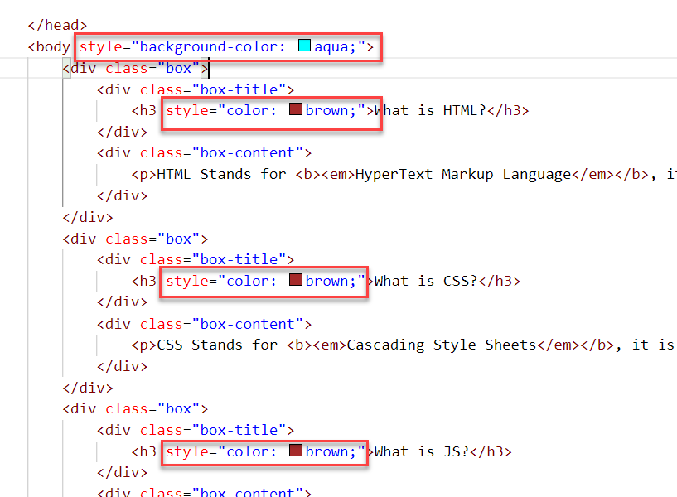
Inline CSS
Inline CSS is used to style a specific HTML element.
To apply Inline CSS add a style attribute to each HTML tag.
Inline styles in CSS could be useful for previewing changes instantly.
It can be useful when adding CSS rules to only one or two elements.
Syntax to apply Inline style CSS
<htmltag style="cssproperty1:value; cssproperty2:value;"> </htmltag>
We can see all the available CSS properties on the W3C:
https://www.w3schools.com/css/default.asp
Disadvantages of using Inline style CSS:
These styles cannot be reused anywhere else.
Adding CSS using this technique is time-consuming.
These styles are tough to be edited because they are not stored at a single place.

Slide 47
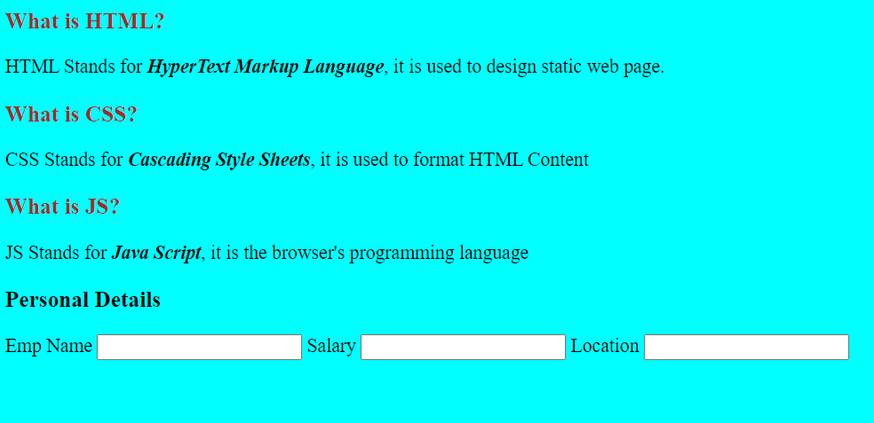
Hands – on: Inline CSS
Apply basic style to our html page using the Inline CSS technique.
For this exercise we will create a new file named cssbasics.html in our current folder.
Code Link:
cssbasics.html

Slide 48
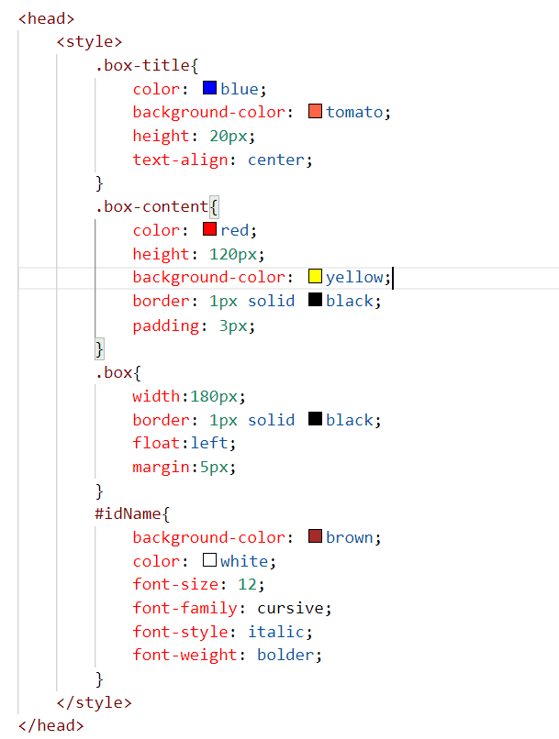
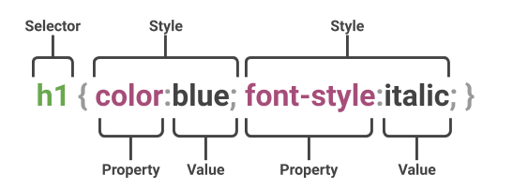
Internal CSS
The internal style sheet is used to add a unique style for a single document. It is defined in <head> section of the HTML page inside the <style> tag.
This CSS style is an effective way to style single pages.
Internal CSS is applied using the Selectors in the HTML page, which makes the styling easy.
Syntax to apply the Internal style CSS
<style>
selector{
propertyname: value;
propertyname: value;
}
</style>
Selector: CSS selectors are used to "find" (or select) the HTML elements you want to style.
The are three type of selectors in CSS.
#id: Id of the single element
.classname: group of elements which has same classification property
Tagname: group of elements which has same tag name

Slide 49
Box Model in CSS
In CSS, the term "box model" is used when talking about design and layout.
All HTML elements can be considered as boxes.
The CSS box model is essentially a box that wraps around every HTML element. It consists of: margins, borders, padding, and the actual content. The image below illustrates the box model:
margin
border
border
padding
Html element
Html element

Slide 50
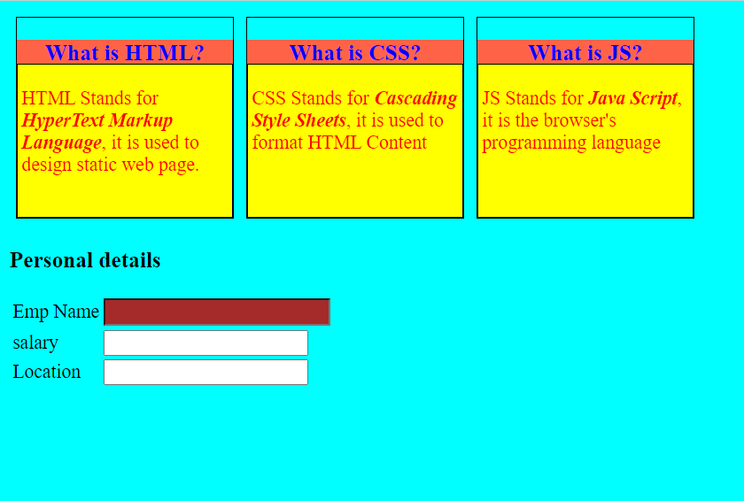
Hands – on: Internal CSS
Now will apply the CSS using the Internal style CSS to our block level elements (box and box-content), will also see how to use different types of selectors for styling the content.
We will also see some commonly used properties of CSS.
Code Links:
cssbasics.html

Slide 51
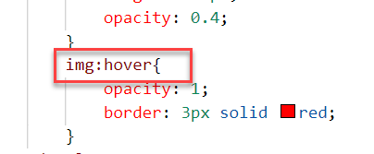
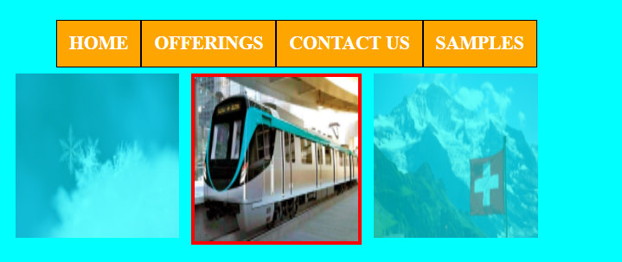
Pseudo-classes in CSS
A pseudo class is used to apply effects on the control based on special conditions or activity.
For example, it can be used to:
Style an element when a user mouses over it
Style visited and unvisited links differently
Style an element when it gets focus
Syntax to use pseudo class
selector:pseudo-class { property: value; }

Slide 52
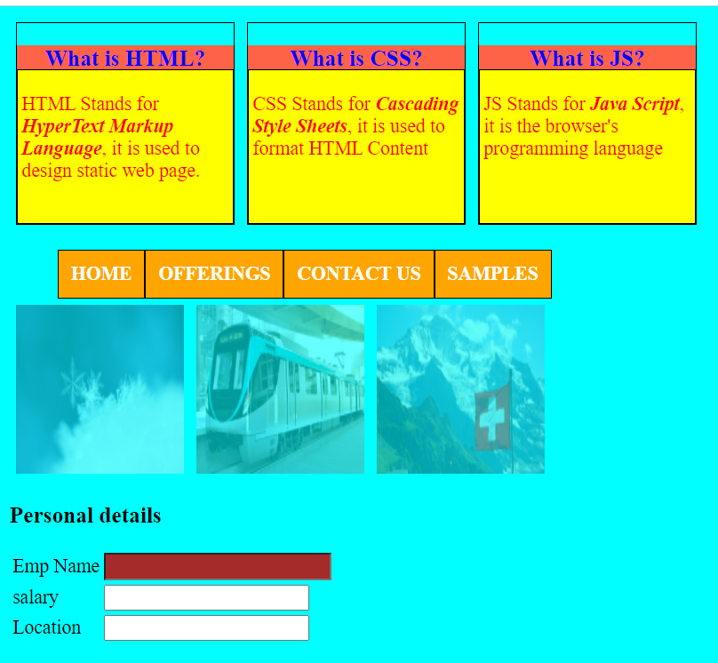
Hands – on: Pseudo Classes in CSS
Add three images and style them using the hover class of CSS. So when we hover the mouse on the image gets highlighted.
Also create a Navbar in our HTML Page.
In this exercise we will also see how to apply styling on the child elements using the parent element..
Code Links:
cssbasics.html

Slide 53
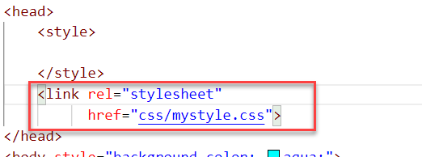
External CSS
In external CSS, we link the web pages to the external .css file.
This CSS type is a more efficient method, especially for styling a large website. By editing one .css file, you can change your entire site at once.
Since the CSS code is in a separate document, your HTML files will have a cleaner structure and are smaller in size.
An external style sheet can be linked to an HTML document using the <link> tag. The <link> tag goes inside the <head> section.

Slide 54
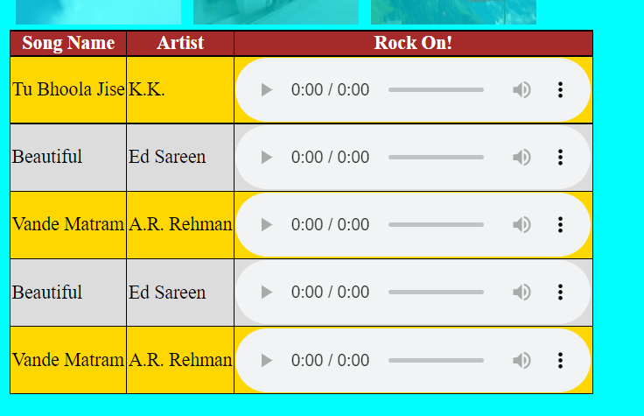
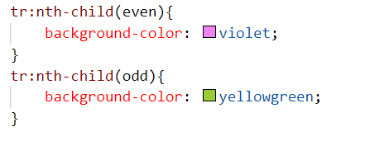
Hands – on: External CSS
Now we will use the External style CSS to style our HTML page.
We will also style our table element to demonstrate the concept of styling the child elements.
Exercise code:
cssbasics.html
mystyle.css

Slide 55

What is JavaScript?
JavaScript is the Programming Language for the Web. Simply, JavaScript is browser’s programming language.
Every browser directly understand JavaScript.
Java and Java Script are completely different in their design, purpose and usage.
JavaScript is the world's most popular programming language.
JavaScript is among the most powerful and flexible programming languages of the web. It powers the dynamic behavior on most websites.
There are two types of JavaScript:
Client-Side JS
Server-Side JS
Client-Side JS:
When the JS code runs on the client side (browser), then it is known as Client-side JS.
It is simple, easy and used in web development.
Since the code runs on client side, it is extremely fast and we can test/debug it directly in browser.
Server-side JS:
When the JS code runs on the server side, then it is known as Server Side JS.
This gives a benefit to developer to learn only one language with which they can code on both side.
Server side JS can be used to validate data, db look ups, send mails, trigger integration.
NodeJS is one of the example of Server Side JS. (It is a framework developed to work on server side).

Slide 56
Basic Usage of JavaScript
JS can used to show output to user.
It is used to Validate user input.
We can change the CSS at runtime using the JavaScript.
Manipulate the DOM
Access the HTML Elements and their properties/values
Send call to server
Develop Application logic
To display dialog boxes and pop-up windows.

Slide 57
Some Important Point related to JavaScript
JavaScript is case-sensitive. E.g value and Value are not same (80% developers does case-sensitive errors)
Every statement in JS ends with semi-column (;).
The variable names and function names follow camel-case naming convention which means first letter of first word is small and next consecutive word’s first letter is caps.
Ex:-
iloveindia ➔ iLoveIndia
wearelearningJS ➔ weAreLearningJs
We can declare variable in JS without specifying any data type, based on the value assigned the data type is automatically picked, the keyword to declare variable is var.
Java script unlike other programming language is a asynchronous non-blocking i/o.
JS offers 2 built-in objects
document – the object of DOM, using this object we can access HTML elements of our page.
window – it is the object of browser window
Symbols will have special meaning
( ) – parenthesis: Define the function
{ } – braces: Define the Scope , It is used to define { key: value, key: value }
[ ] – bracket: Define the Array [1,3,4,5]-> Array
In JS = is an assignment operator, == and === are comparison operator, == compare only value and === compare data type and value both.
We can run JS on Console. To open Console press F12 on the browser window.

Slide 58
Variables and Data Types
Variables: Variables are containers for storing data (storing data values).
Data Types: Data types in JavaScript describe the different types or kinds of data that you will be working with and storing in variables.
JavaScript Data Types
Primitive
Non-Primitive/Reference
String
Array
Object
Number
Boolean
Undefined
Null
Symbol

Slide 59
Arrays and Objects in JS
Array
An Array is a collection of data and a data structure that is stored in a sequence of memory locations.
One can access the elements of an array by calling the index number such as 0, 1, 2, 3, …, etc.
Index in an array always starts with ‘0’ (zero).
The array can store data types like Integer, Float, String, and Boolean all the primitive data types can be stored in an array.
Syntax to define an array
var arrName = [item0, item1,….];
Object
An Object is a non-primitive, structured data type in JavaScript.
Objects are same as variables in JavaScript, the only difference is that an object holds multiple values in terms of properties and methods.
Syntax to define an Object
var oObjName = { “prop”: value,
“prop”: value,
“prop”: value }
Note:
JSON stands for Java Script Object Notation.
We can validate JSON over jsonlint https://jsonlint.com
Ex:
var myArr = [1, 2, 3, 4, 5];
var myArr2 = [‘a’, ‘b’, ‘c’];
Example of an Object
{
"empStructure": {
"empNo": 100,
"empName": "Latika Roongta",
"salary": 9000,
"currency": "EUR"
}
}
Entity set
Elements or properties

Slide 60

Hands – on: JS Basics
Understand some basic coding of JavaScript in the browser Console.
Code link:
JSBasics

Slide 61
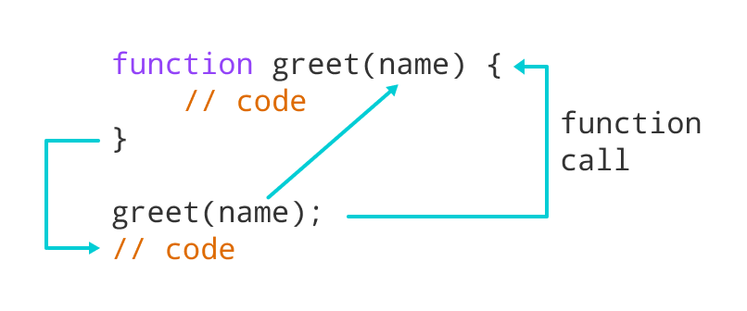
Function in JavaScript
Functions in JavaScript
A JavaScript function is a block of code designed to perform a particular task.
A JavaScript function is executed when "something" invokes it (calls it).
A JavaScript function is defined with the function keyword, followed by a name, followed by parentheses ().
The code to be executed, by the function, is placed inside curly brackets: {}
Function parameters are listed inside the parentheses () in the function definition.
Function arguments are the values received by the function when it is invoked.
Inside the function, the arguments (the parameters) behave as local variables.
Types of functions
Functions are of 2 types →
1. Anonymous function 2. Named Function
function(params) {
//code
}
function functionName(params) {
//code
}

Slide 62
How to Apply JavaScript
JavaScript can be applied to an HTML Page in three ways
Inline JS – The script code is applied at html element level using events e.g., onclick, ondblclick, onhover, onkeypress. This is not recommended as its not reusable.
Internal JS – We write script code inside a script tag. We can use functions for that. There are 2 types of function. Which means it is reusable.
External JS – JS code is written in another file which has extension as .js. We will link it with our script tag. In the same way we linked CSS with link tag.
List of JavaScript Events:
https://www.w3schools.com/jsref/dom_obj_event.asp
document: document is the object of DOM, it is used to access the DOM elements easily. It’ll provide ready to use API (functions) which are built in to access objects of DOM elements (html element).
getElementsByClassName
getElementsByTagName
getElementById

Slide 63
Hands – on: Inline and Internal JS
Now will apply JavaScript to our HTML page using the Inline and Internal method.
For this exercise we will create a new file named JSBasics.html in our current folder.
Part 1: Inline JS
We will create a button in the HTML page using the <button> tag and on press of that button we will show an alert message to the user.
Code Link:
JSBasics.html
Part 2: Internal JS
We will create to a form using the <label> and <input> tag in the page. It will have a username and password field. When the user enter the same value in both of the field and press the login button show success to the user else show error.
Code Link:
JSBasics.html

Slide 64
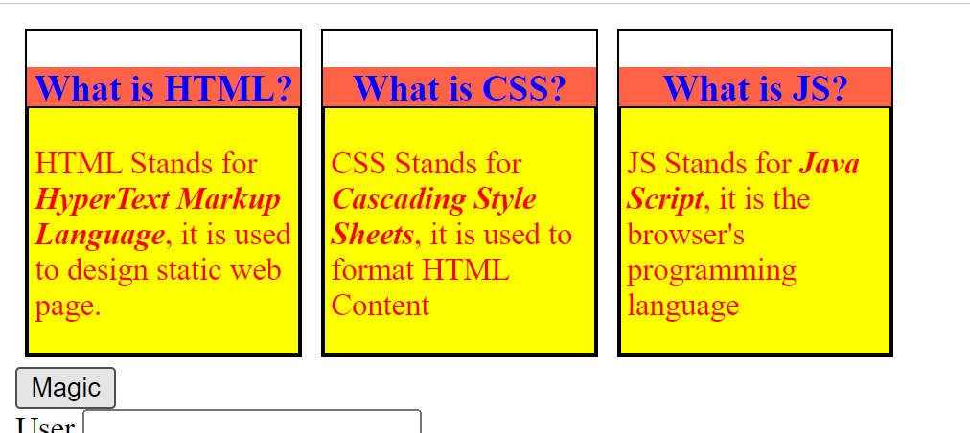
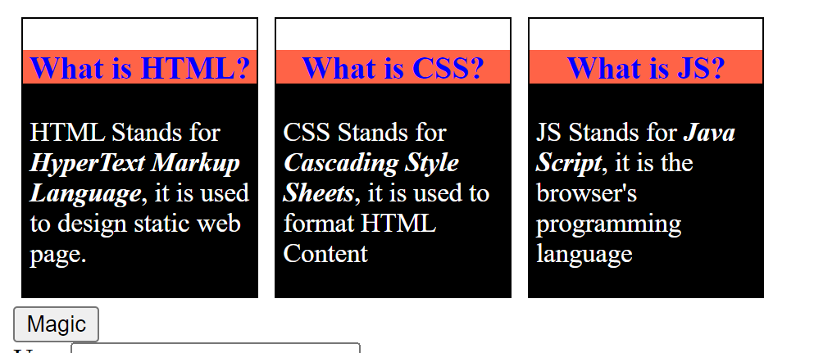
Hands – on: Changing the CSS at runtime
Now we will change the style properties of the elements in the HTML page at the runtime.
For this we will add a Magic Button on the page, on press of that we will change the color of the box-content.
Code Link:
JSBascis.html

Slide 65
Hands – on: Adding Dynamic Content
Now we will see how to add content dynamically to our HTML page at runtime.
For this we will add a new input field and a button to the page and on press of the button whatever is written in the input field will be printed on the page.
Code Link:
JSBasics.html

Slide 66
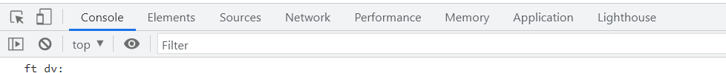
Debugging
Debugging is the process of detecting and removing of existing and potential errors (also called as 'bugs') in a software code that can cause it to behave unexpectedly or crash.
In order to debug our code, press F12 in browser window and go to the Source tab. In source tab set up the Break point by clicking on the line number.
Shortcuts for debugging are shown below:
Type | ABAP | JS
Step-in | F5 | F11
Step-out | F7 | Shift+F11
Go to next | F6 | F10
Continue (till Next BP) | F8 | F8
There are several tabs in the console, while working on the application we are mainly focused on Console, Elements, Source and Network Tab.
Console: It is the place where we run the JavaScript Code and Print the output for testing and Debugging
Elements: It shows the DOM of the current page open in browser.
Source: All the JavaScript code of the app or page will be visible here. We can also debug the code form here.
Network: We can see all the Network related calls made by the application in this section.

Slide 67
Synchronous and Asynchronous Response
User
Screen
Server
Database
Save
Processing
Time
Request send to server
Request to Database
Synchronous Response
For all this time user
Remains blocked
Response form Database
Save
Request send to server
For all this time user
Remains blocked
Request to Database
Asynchronous Response
For all this time user
Is Not Blocked
Response from the server
Response form Database
Callback

Slide 68

Introduction to jQuery
jQuery is a java script library, which is used to simplify our JS code.
The moto is to minimize JS code size.
Why we use jQuery?
It’s free to use (Open Source)
Used by top software companies like google, Netflix, etc.
Light weight JS library
jQuery greatly simplifies JavaScript programming.
Available on internet
Purpose is to write less and do more
Industry standard
How to use?
Download the jQuery library and keep it in our project, just like we use util/mycode.js
Reference jQuery from CDN (Content Distribution/Delivery Network) – directly reference it from internet
Documentation of jQuery is available @ https://jquery.com

Slide 69
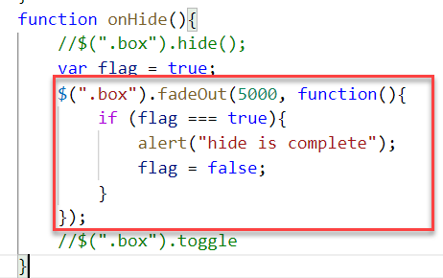
Syntax of jQuery
The jQuery syntax is tailor-made for selecting HTML elements and performing some action on the element(s).
Basic syntax is:
$(selector).action()
$ sign indicated to the browser that we want to use jQuery.
selector: selector is same what we have seen in CSS i.e., #id, .class, tagName
Action(): It is a JavaScript Event or Action which we want to perform on the selected element.
Example:
$("p").hide() - hides all <p> elements.
$(".test").hide() - hides all elements with class="test".
$("#test").hide() - hides the element with id="test".

Slide 70
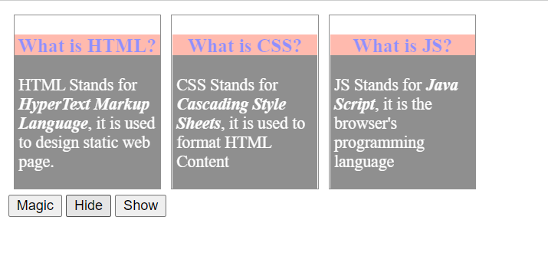
Hands – on: Adding effects using jQuery
Create a new file named jQBasic.html in the Basics folder which we have used for html, css and JavaScript.
Bring the code related to the box and box-content form the previous example.
Now we will add some effects to these boxes using the jQuery actions.
Code Link:
jQBasics.html

Slide 71
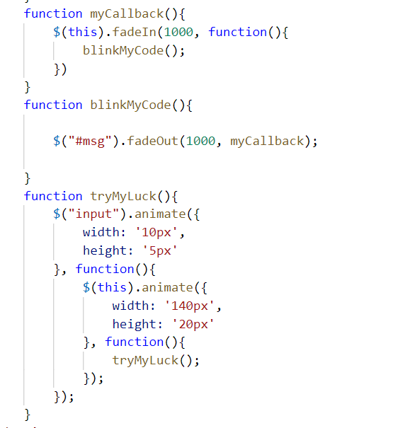
Hands – on: Adding Animation
Now we will add some animations to our html page using the jQuery.
For this we have to bring back the login fields code back form the previous examples.
Code Link:
jQBasics.html

Slide 72
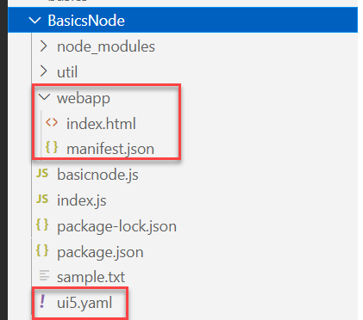
Hands – on: Starting an App using NodeJS
Now we will serve a basic html page on the local server with the help of ui5 tooling.
But before we start we have to install a few dependencies:
ui5 cli:- npm install @ui5/cli to install globally: npm install -g @ui5/cli
ux-ui5 tooling:- npm install @sap/ux-ui5-tooling to install globally: npm install –g @sap/ux-ui5-tooling
Now we have to create a webapp folder in our node project folder, and in that webapp folder create two files index.html and manifest.json.
Also create a ui5.yaml file in the project folder.
Add the required code in all the files form the links provided below.
Now to run the project use command: ui5 serve
Code Links:
index.html
manifest.json
ui5.yaml

Slide 73


End of Day 1

Slide 74

Questions

Slide 75

Srinivas

